Slide 1
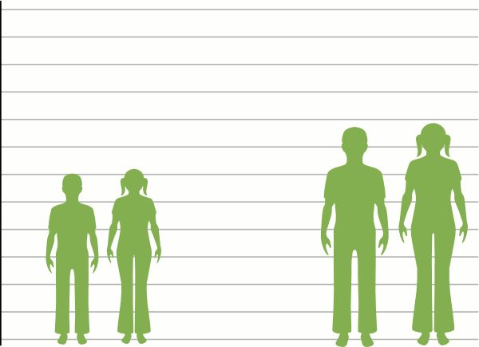
CHILD HEIGHT PREDICTION
Project Mentor :
Prof. Arnab Chakraborty
Team Members :
JAYANTH REDDY
HIMANTH.KAKI

Slide 2
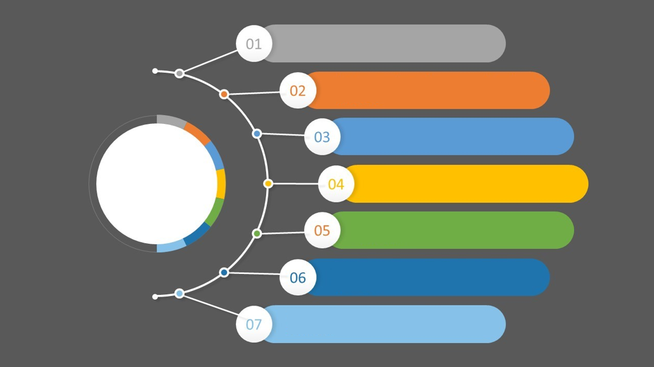
Contents
Project Objective & Scope
Data Description
Methodology
Data Preprocessing
Models Used
Accuracy Comparison
Future Scope of Improvements

Slide 3
Project objective & scope
Objective
Provided : A small dataset which contains heights of parents and their children taken from Kaggle (contains training and test data).
Outcome : To Predict child height based upon parents data.
Final : Apply on the test dataset and compare with the differences in the results.
Scope
It is a useful project as the Regression models can be used to quickly predict the child height of large datasets.
The results might have some mismatch with the real-world applications. But that can be avoided if the models are trained for small datasets.

Slide 4
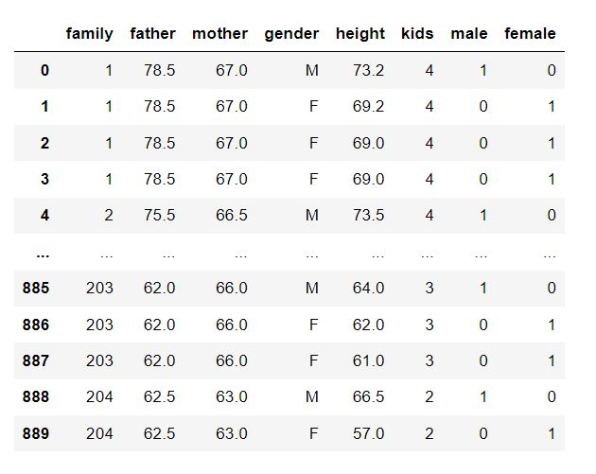
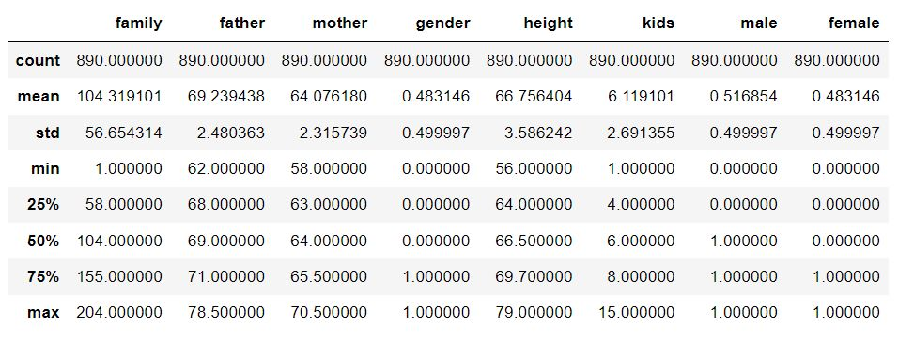
Data description
The description of the data with type and description of each Attribute is given in the table.

Slide 5

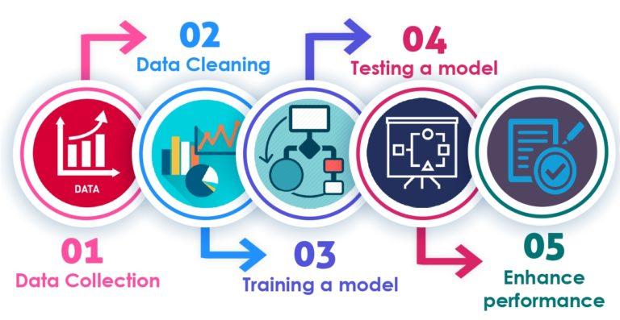

Slide 6
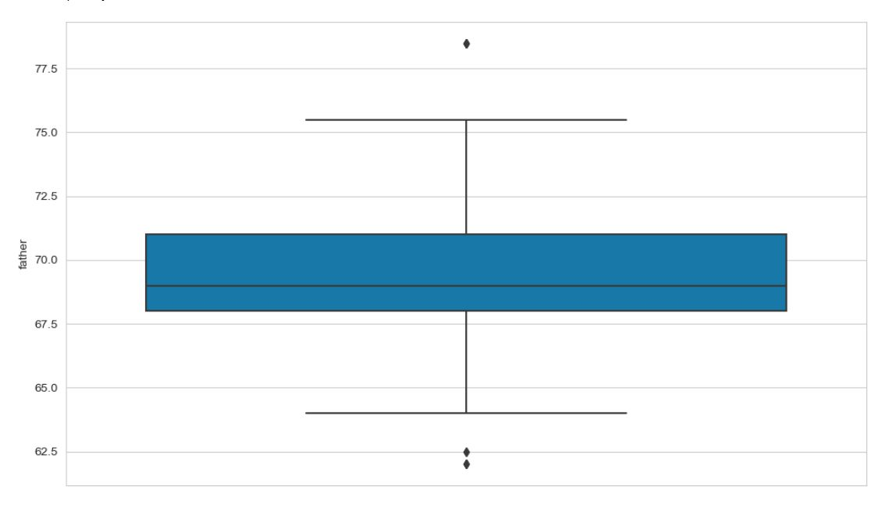
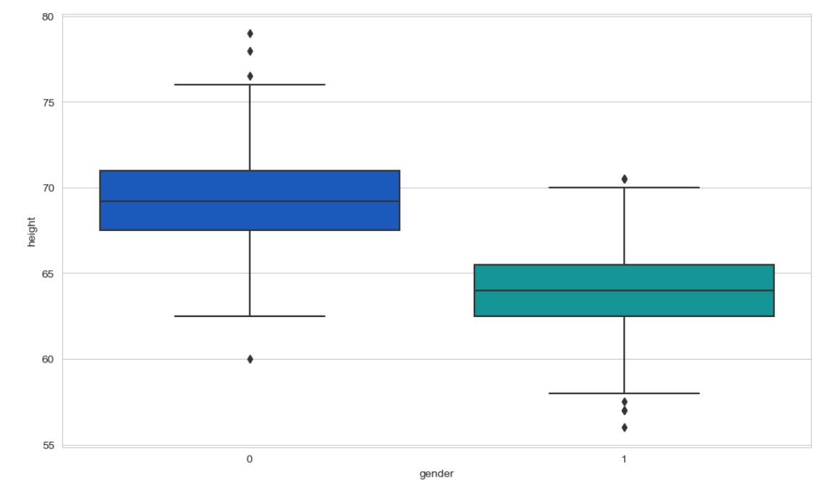

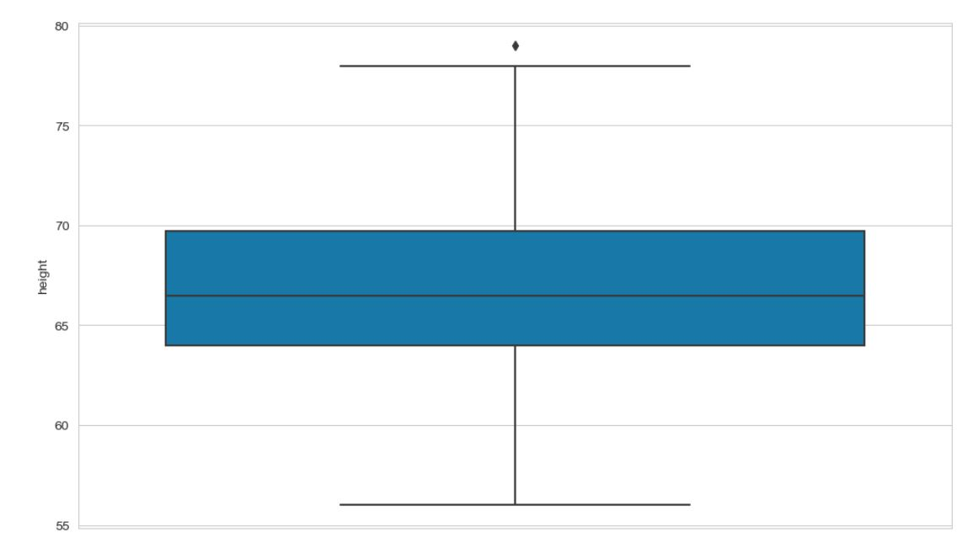
Data Preprocessing
We have changed the categorical values into numeric values.

Slide 7
Models used
The Machine Learning models used for this project are:
Linear Regression
Decision Tree Regression
Random Forest Regression
Gradient Boosting Regression

Slide 8
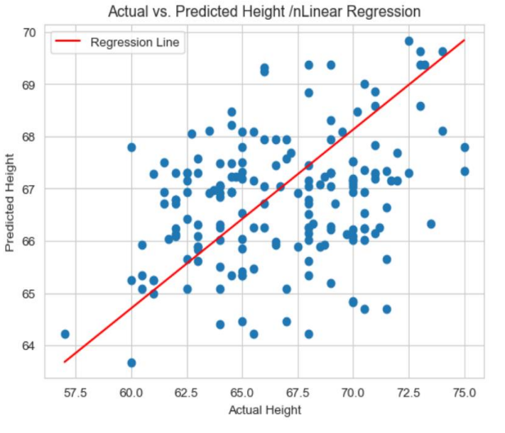
Linear Regression
Linear regression is a statistical method for modeling the relationship between a dependent variable and one or more independent variables. The formula for linear regression is y = mx + b, where y is the dependent variable, x is the independent variable, m is the slope of the line, and b is the y-intercept.
The slope, m, represents the change in y for every unit change in x. It is calculated as m = (nΣ(xy) - ΣxΣy) / (nΣ(x^2) - (Σx)^2), where n is the number of observations, Σ is the sum of the values, and x and y represent the independent and dependent variables, respectively. The y-intercept, b, represents the value of y when x is equal to zero.

Slide 9
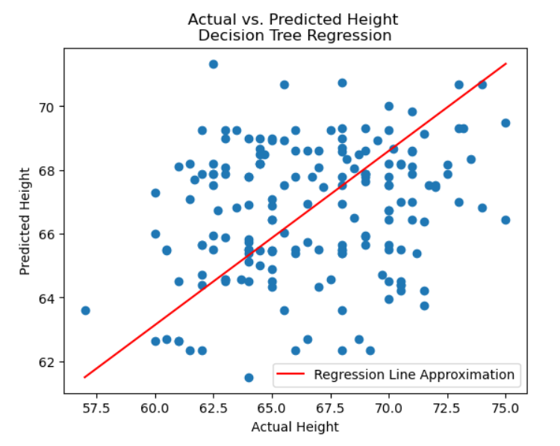
Decision Tree Regression
Decision tree regression is a powerful machine learning technique that can be used to predict continuous values. The formula for decision tree regression involves breaking down a dataset into smaller subsets, and recursively applying the same process to each subset until a stopping criterion is met. This results in a tree-like structure where each internal node represents a test on an attribute, each branch represents the outcome of the test, and each leaf node represents a prediction.The key components of the formula include the splitting criterion, which determines how to split the data at each internal node, and the stopping criterion, which determines when to stop growing the tree. Other important factors include the maximum depth of the tree, the minimum number of samples required to split an internal node, and the minimum number of samples required to be at a leaf node. By adjusting these parameters, we can control the complexity of the model and prevent overfitting or underfitting.

Slide 10
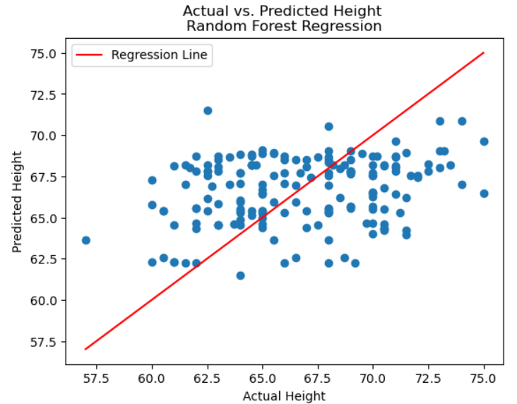
Random Forest Regression
Random forest regression is an ensemble learning method that combines multiple decision trees to improve the accuracy of predictions. The formula for random forest regression involves creating a set of decision trees on randomly selected subsets of the data, and then averaging their predictions to obtain the final output. Each tree is trained on a different subset of the data, and at each node, a random subset of features is considered for splitting. This randomness helps to reduce overfitting and improve generalization performance.The key components of the random forest regression formula include the number of trees in the ensemble, the maximum depth of each tree, the minimum number of samples required to split an internal node, and the minimum number of samples required to be at a leaf node. By adjusting these parameters, we can control the trade-off between bias and variance, and optimize the predictive performance of the model.

Slide 11
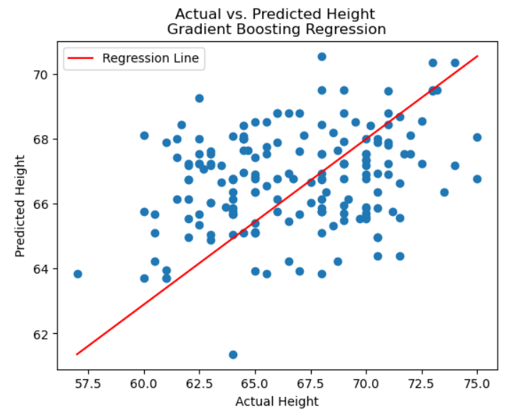
Gradient Boosting Regression
Gradient boosting regression is another ensemble learning method that combines multiple weak models to create a strong predictive model. Unlike random forest regression, gradient boosting regression builds trees sequentially, with each new tree attempting to correct the errors of its predecessors. The formula for gradient boosting regression involves minimizing a loss function by iteratively adding decision trees to the model, where each tree is trained on the residuals of the previous tree. This process continues until a specified number of trees is reached or the loss function cannot be further reduced.The key components of the gradient boosting regression formula include the learning rate, which controls the contribution of each tree to the final prediction, the maximum depth of each tree, and the number of trees in the ensemble.

Slide 12
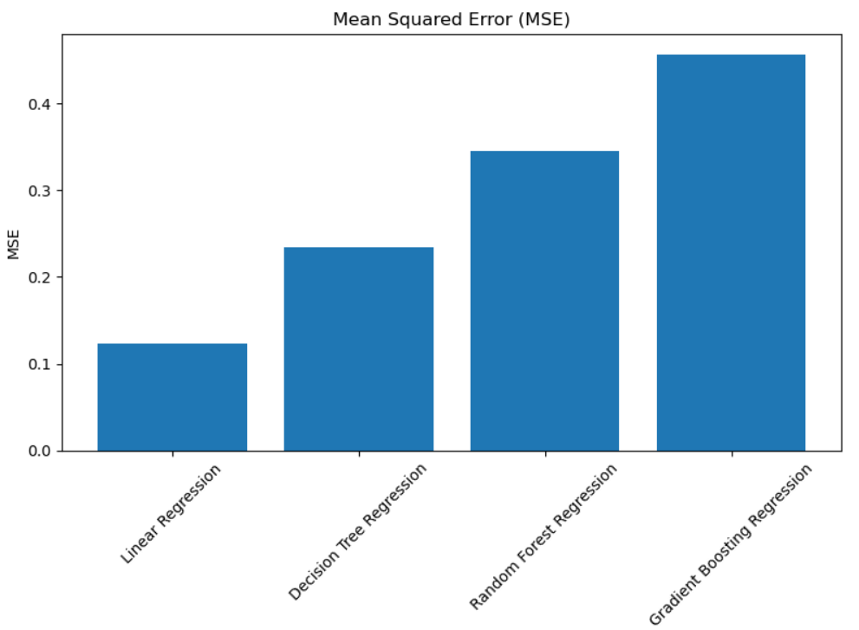
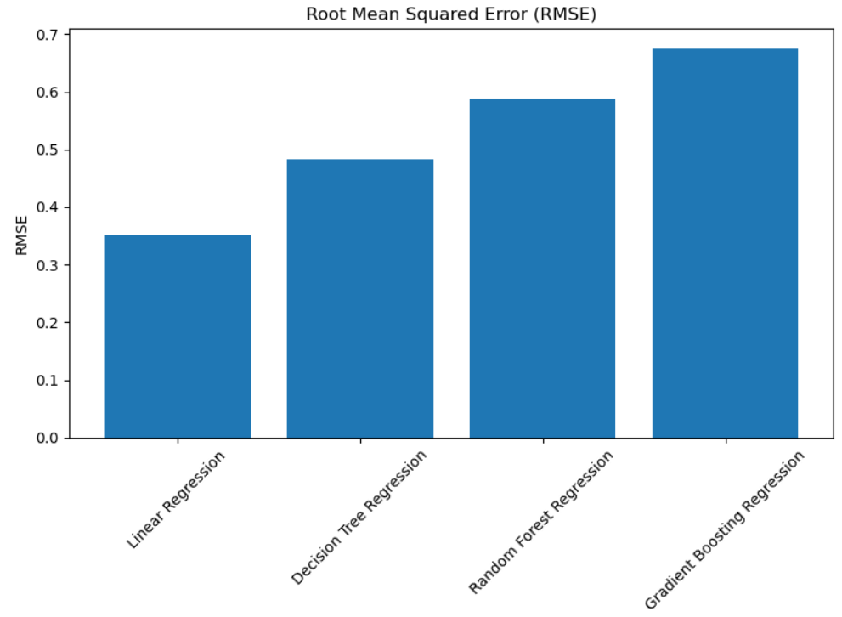
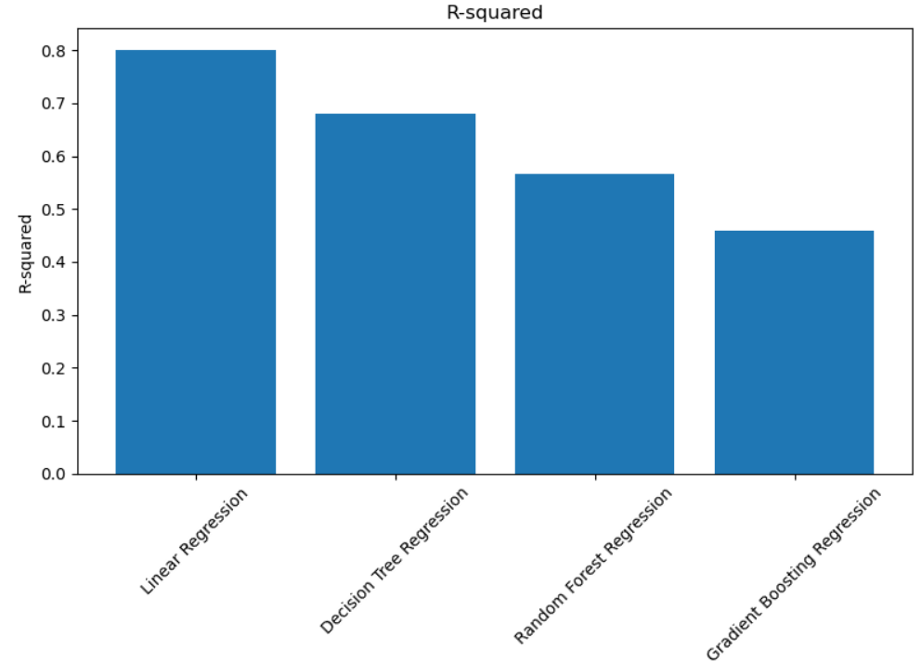
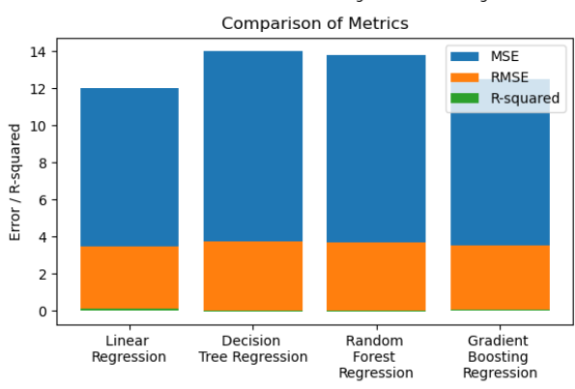
Comparison OF ALL THE MODELS

Slide 13
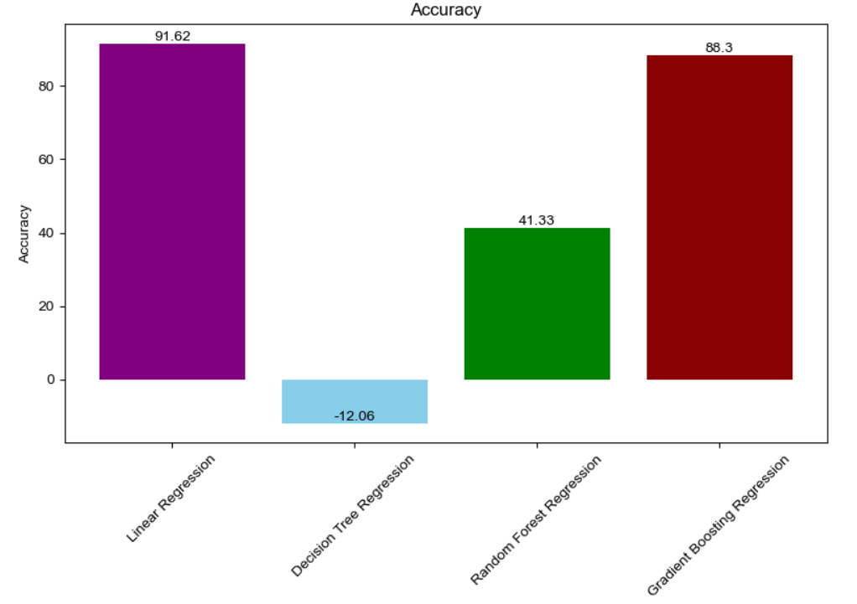
Accuracy comparison graph
Models Used | Accuracy %
Linear Regression | 91.62
Decision Tree | -12.06
Random Forest | 41.33
Gradient Boosting | 88.3
The data shown above is an average of multiple test runs.
We see that the highest accuracy for the train dataset is Linear Regression.

Slide 14
In future by using Advanced Machine Learning Models and Integrating the environmental factors we can develop the model more accurately.
By adding the GUI index we can make the model user friendly.
Mismatches can be removed by further training of model.
Future scope of improvements

Slide 15
THANK YOU…!!!
LOVELY PROFESSIONAL UNIVERSITY
JAYANTH REDDY ( jayanthreddy.me@gmail.com )
HIMANTH.KAKI ( kakihimanth@gmail.com )

